Slide 1












Industries
Public Sector
Manufacturing
Retail
Financial Services
Transportation
Education
Health Care
Hospitality
Insurance
Matrimonial
Tour & Travel

Slide 2










Valued Customers

Slide 3
Mobile Apps Portfolio

Slide 4
Applications
Connecting Hearts
United We Care
Decode
Qatalyst
Vryno
DutyGuy
IMSafeNow
The Man Company
Bayer CropScience Seal Scan
Empire Report
Fuel Price
St. Augustine Live Music
Quote-Gen
Farista – Home Delivery
Farista – Business Applications
Social Engine
Inbook – Indian Social Media
Denhen Inventory
CertainTeed
Mexo Cabs
Movado
BEE ERP
ICEGOV
Myish
BottomzUp
SmartPlate
Holbe
Glimpse Analytix
Mylan Pharma

Slide 5

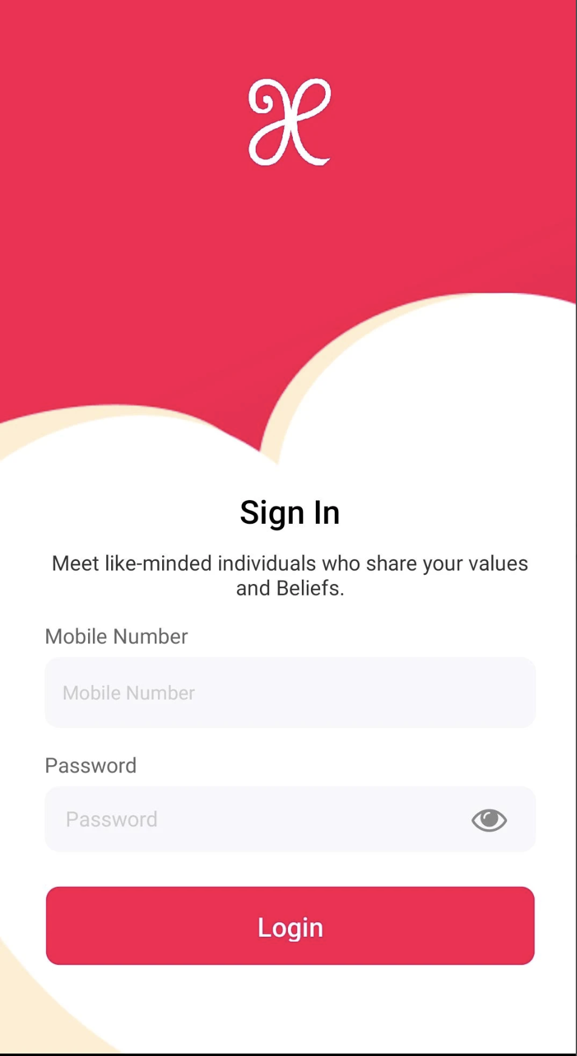
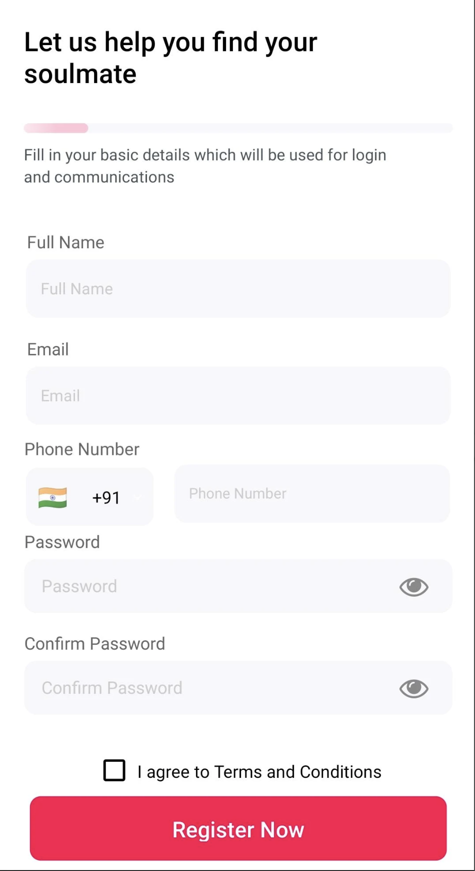
Connecting Hearts
The Connecting Hearts application is designed to link verified users for matchmaking and establishing lifelong partnerships.
This application has been developed for Android devices.
Playstore URL - https://play.google.com/store/apps/details?id=com.connectinghearts&hl=en_IN&pli=1

Slide 6
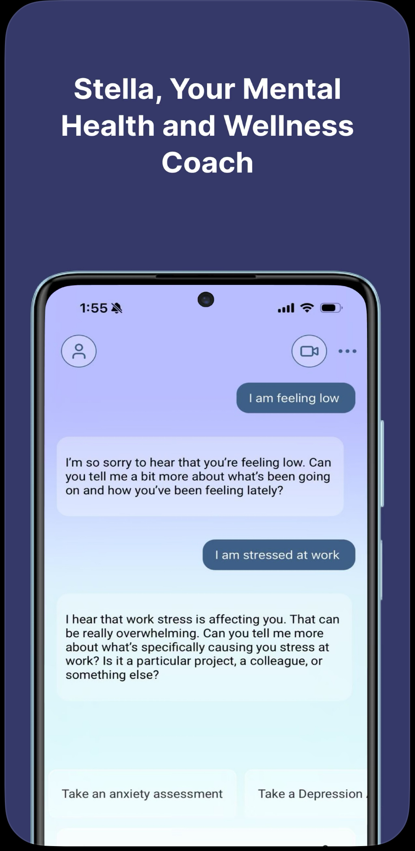
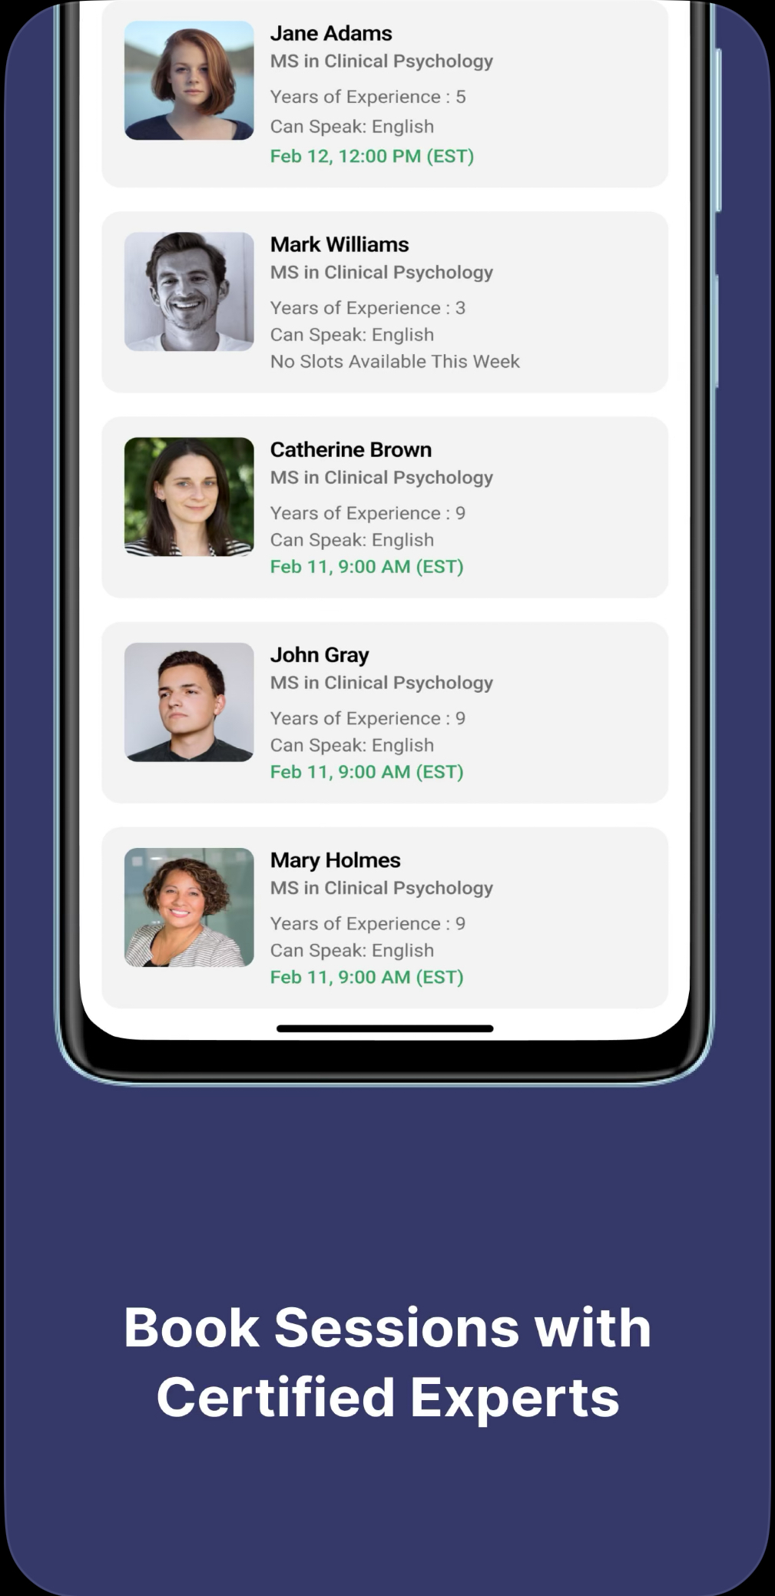
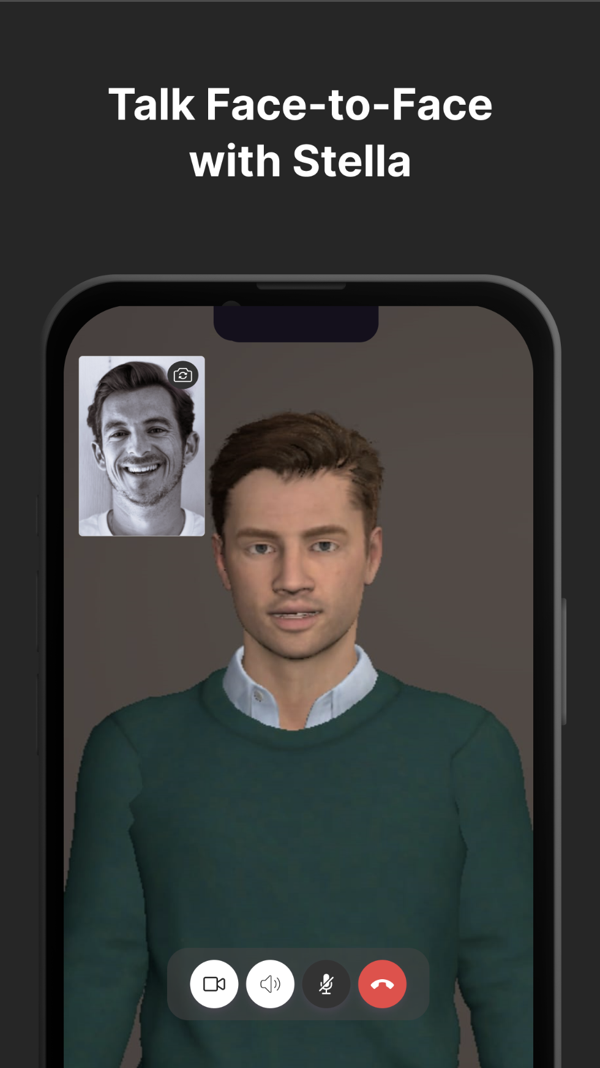
United We Care: Mental Health
The United We Care application is your AI Mental Health and Wellness Coach for your daily guidance and professional care.
This application has been developed for iOS & Android devices.
iOS URL - https://apps.apple.com/in/app/united-we-care/id150132516
Playstore URL - https://play.google.com/store/apps/details?id=com.UnitedFor.Her&pcampaignid=web_share

Slide 7
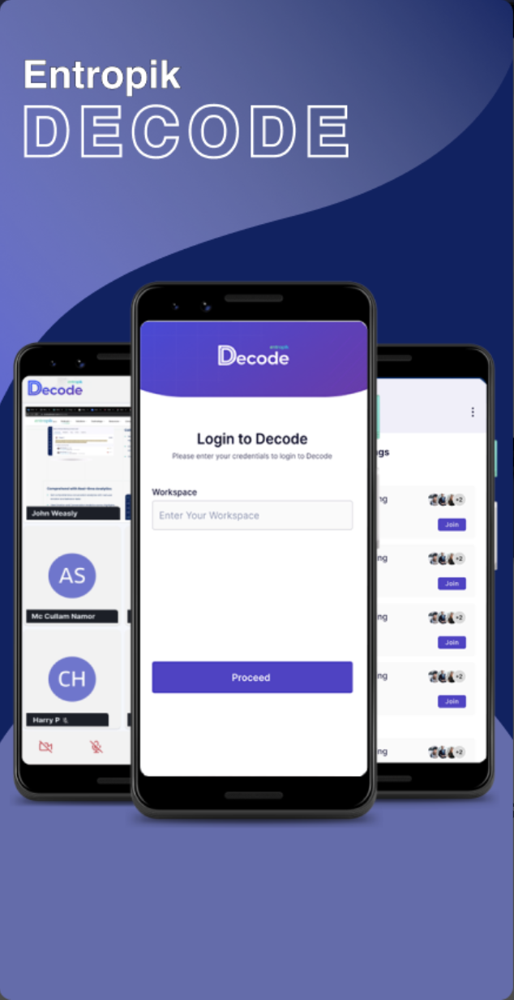
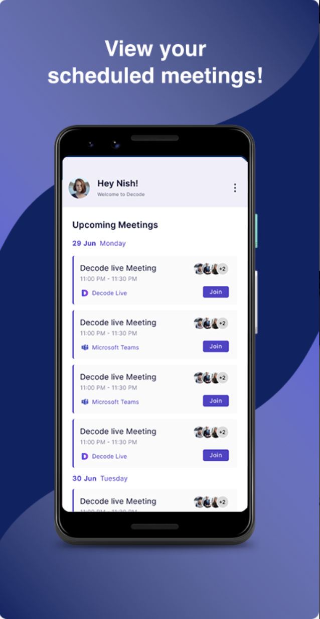
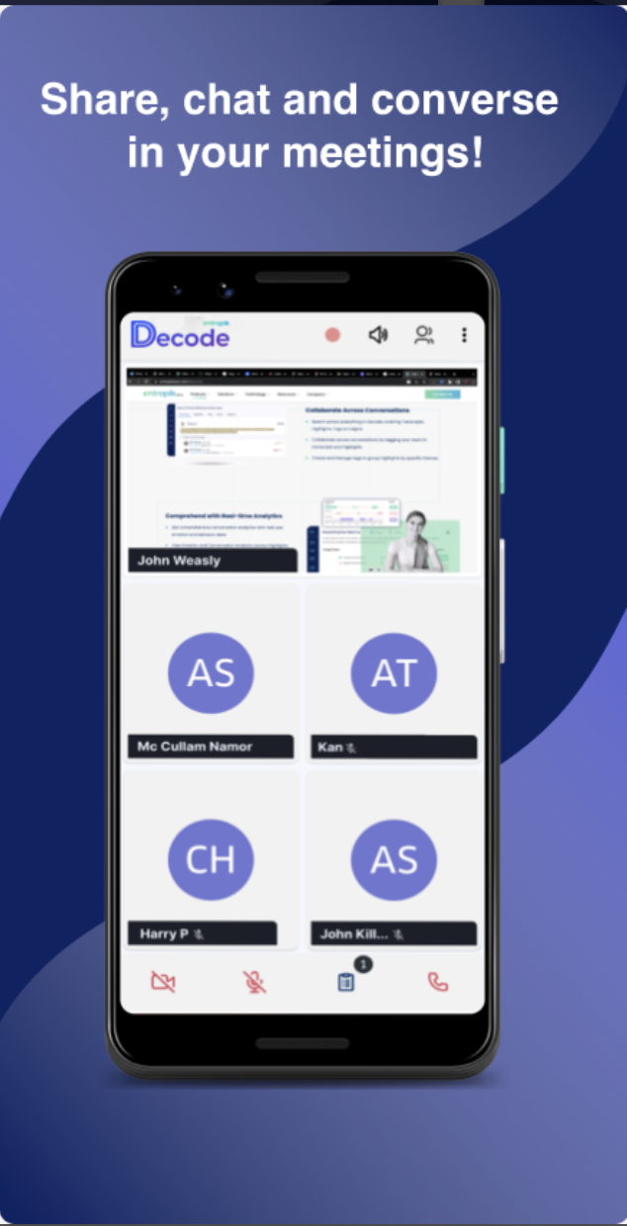
Decode
The Decode Live application is to converse with your customers in real-time and capture emotion insights.
This application has been developed for Android devices.
Playstore URL - https://play.google.com/store/apps/details?id=com.decode.cx&hl=en_IN

Slide 8
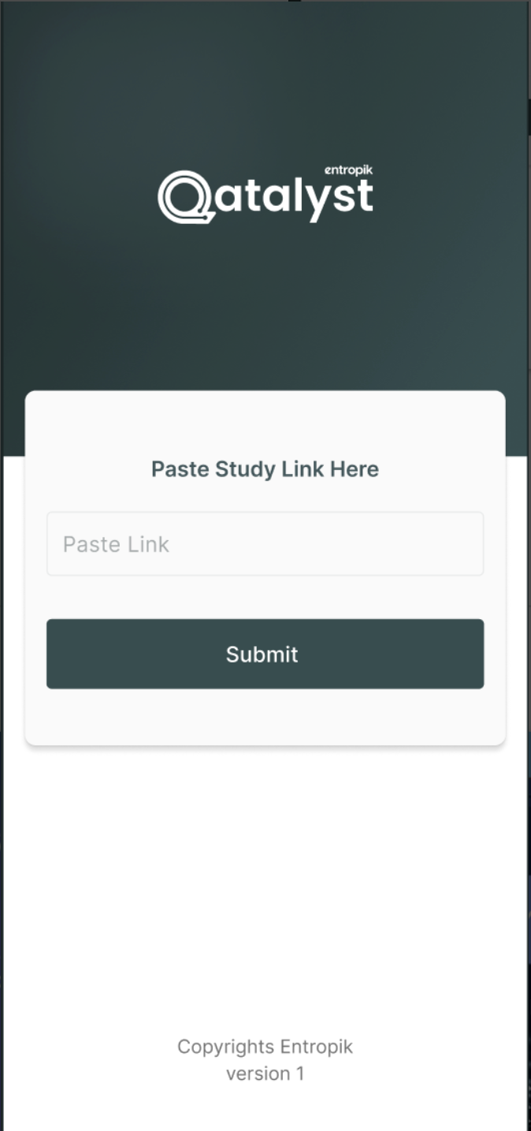
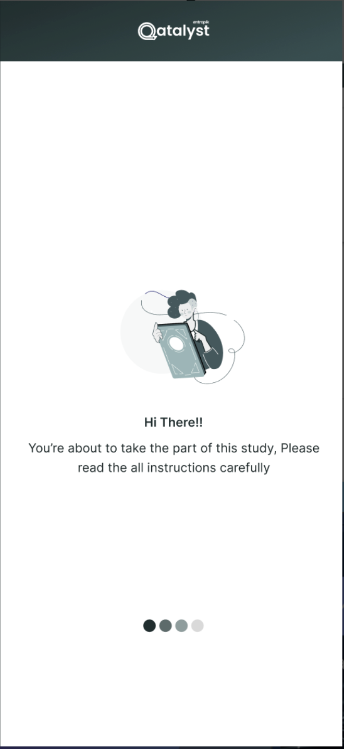
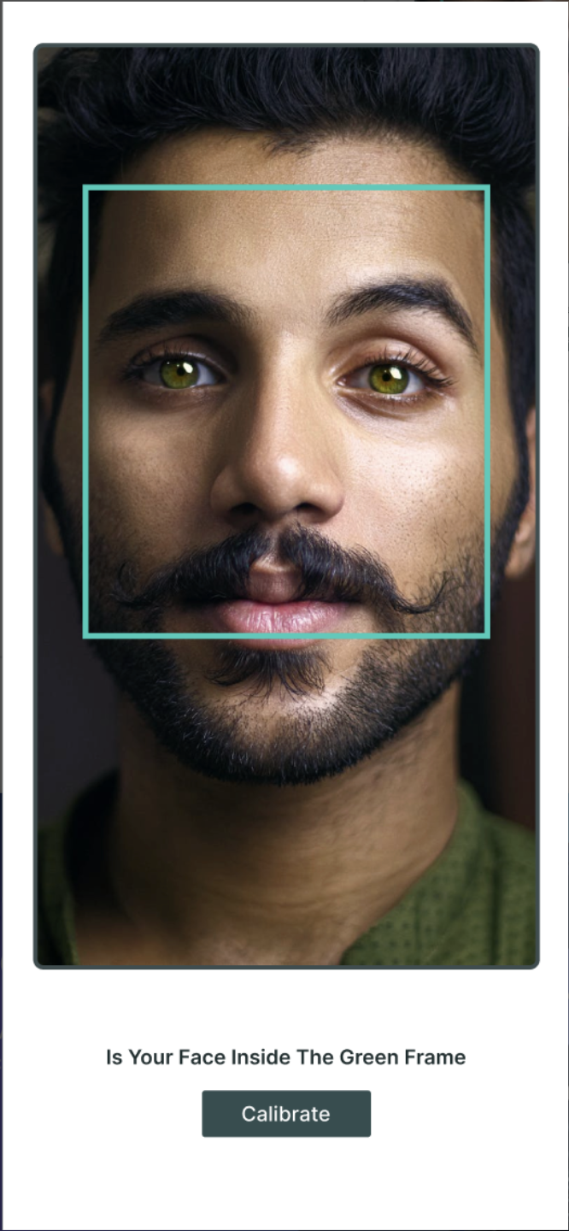
Qatalyst
The Qatalyst application is designed to conduct user research and market research using facial coding and eye ball tracking.
This application has been developed for Android devices.
Playstore URL - https://play.google.com/store/search?q=qatalyst&c=apps&hl=en_IN

Slide 9
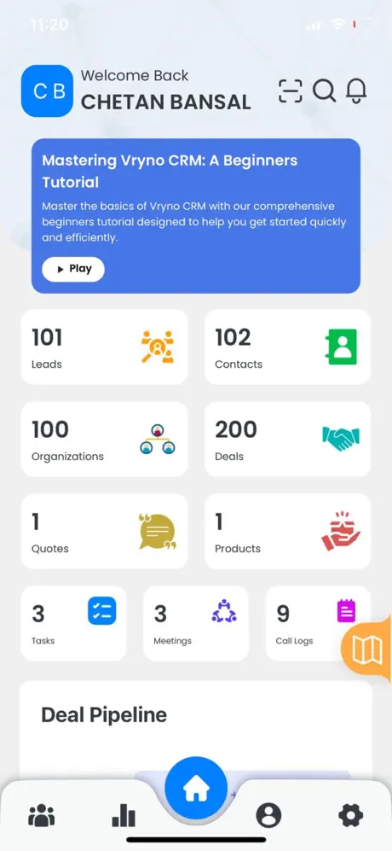
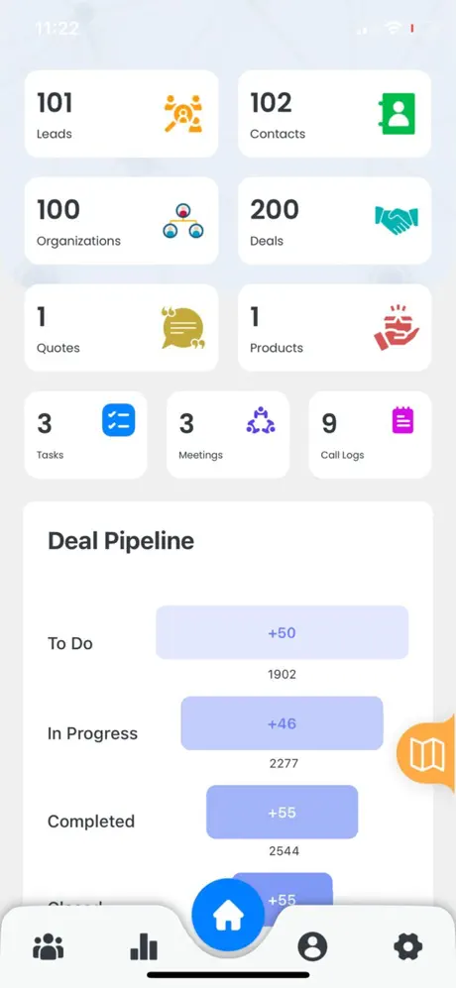
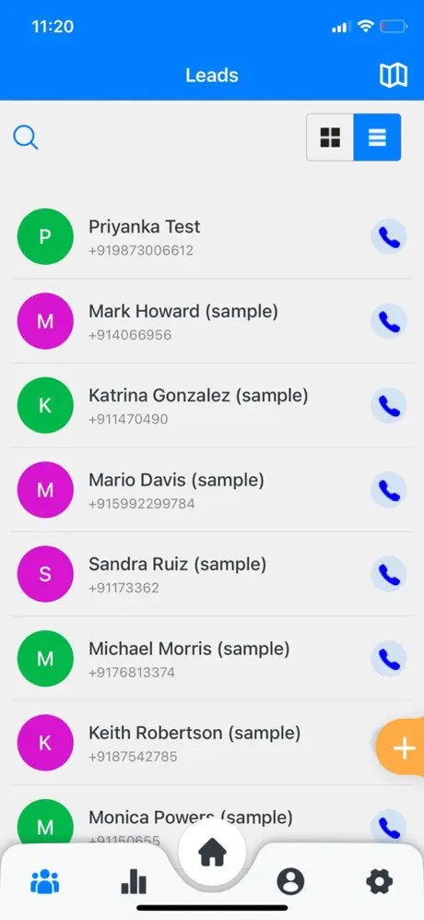
Vryno
The Vryno CRM application is designed for enterprises to manage their Leads/Deals and their current status.
This application has been developed for iOS & Android devices.
iOS URL - https://apps.apple.com/in/app/vryno/id6449392932
Playstore URL - https://play.google.com/store/apps/details?id=com.vryno.crm&hl=en_IN

Slide 10
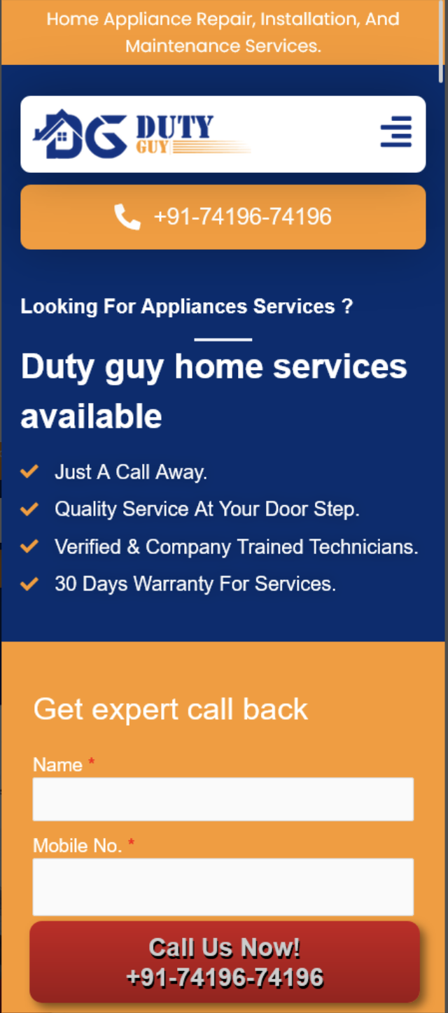
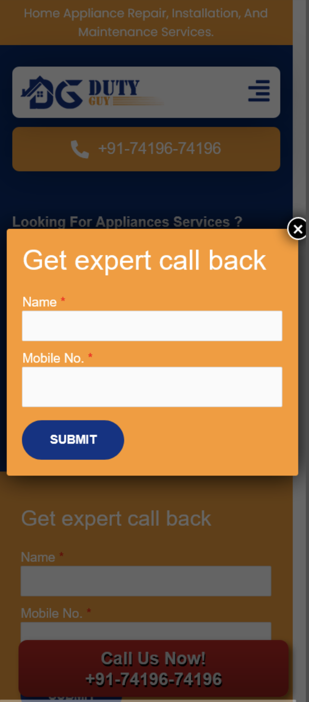
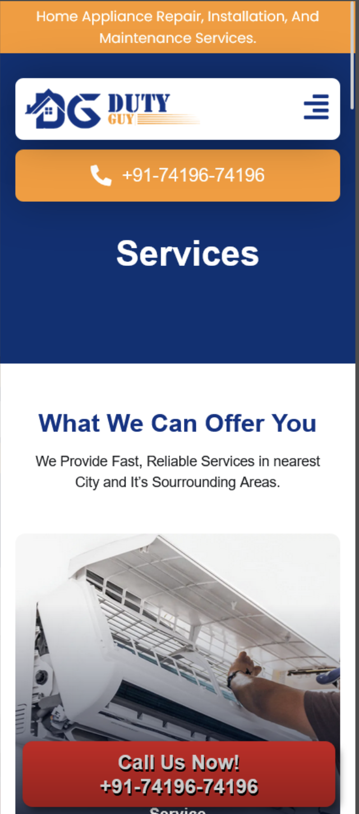
DutyGuy
The DutyGuy application is designed for Services and Repair work to the customer’s doorstep.
This application has been developed for Android devices.
Playstore URL - https://play.google.com/store/apps/details?id=com.dutyguy.twa

Slide 11
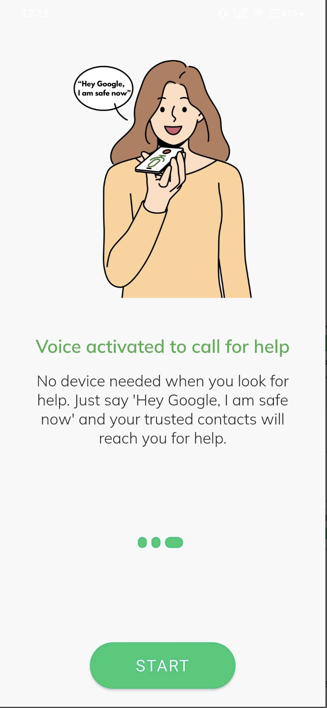
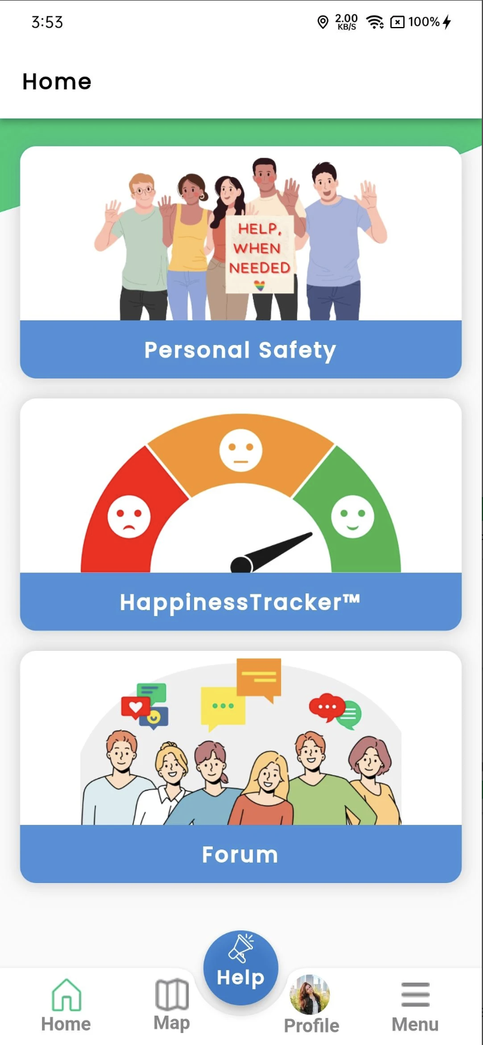
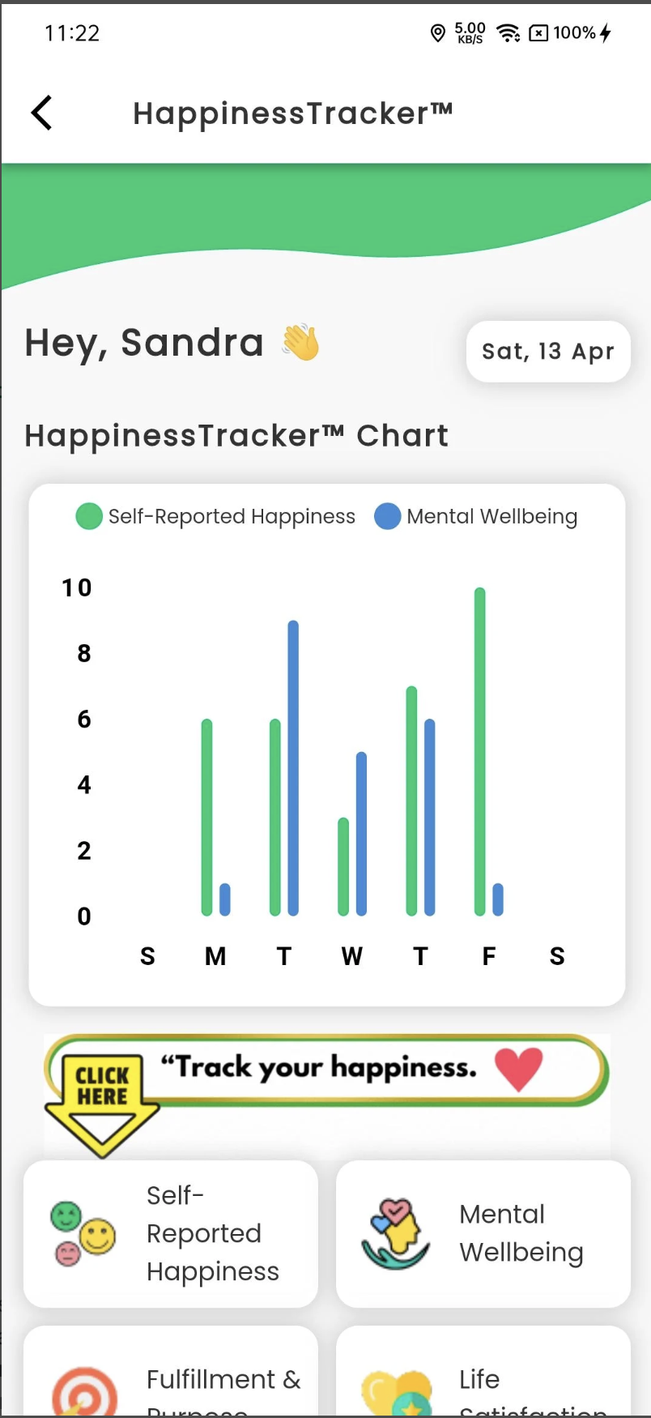
IMSafeNow
The IMSafeNow application is designed track Safety and Mental well being of near and dear ones and also to report issues to concerned people & authorities. This application has been developed for iOS & Android devices.
iOS URL - https://apps.apple.com/in/app/imsafenow/id1526458353
Playstore URL - https://play.google.com/store/apps/details?id=com.lata1&hl=en_IN&gl=US

Slide 12
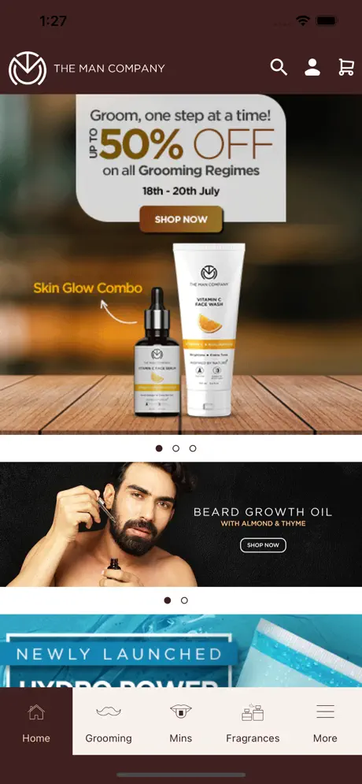
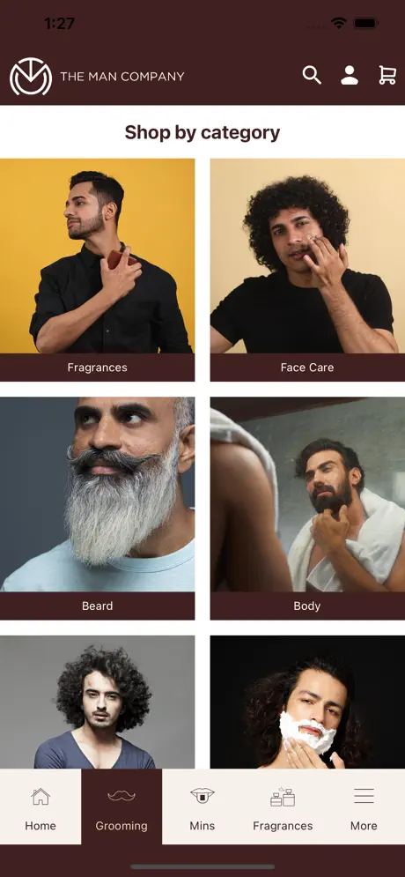
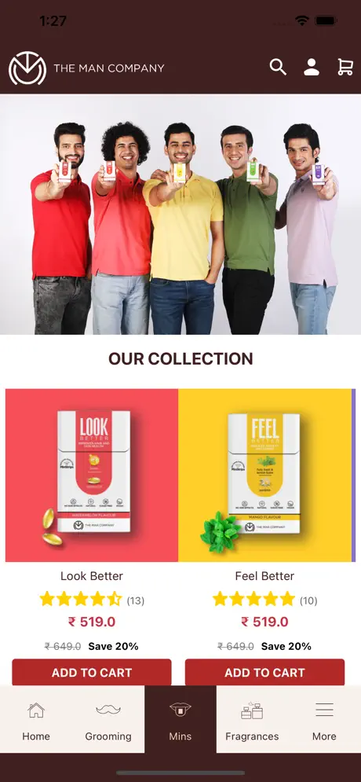
The Man Company
The Man Company application is designed to track, shop and notify users of latest trends and Grooming essentials for Men.
This application has been developed for iOS & Android devices.
iOS URL - https://apps.apple.com/in/app/the-man-company/id1634167429
Playstore URL - https://play.google.com/store/apps/details?id=com.themancompany&hl=en

Slide 13
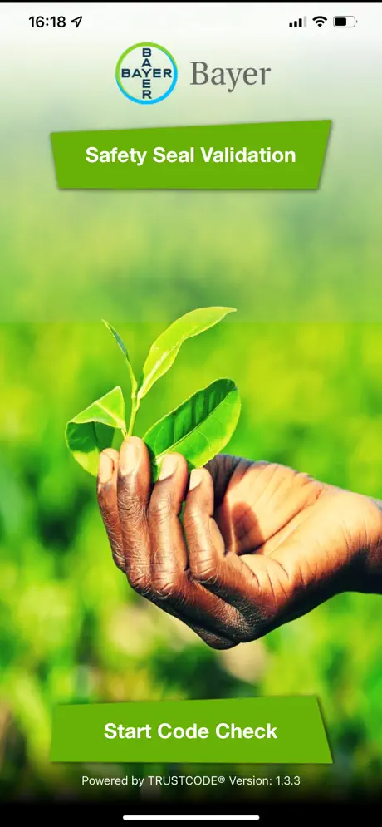
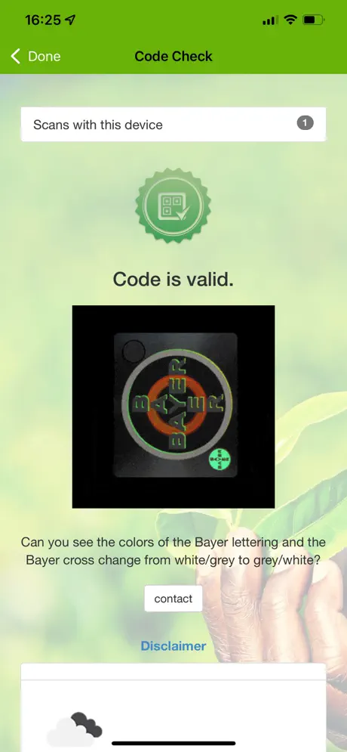
Bayer CropScience Seal Scan
The Bayer CropScience application is to offer Farmers an easy, quick and reliable tool to check the authenticity of the Bayer CropScience products and seeds. This application has been developed for iOS & Android devices.
iOS URL - https://apps.apple.com/us/app/bayer-cropscience-seal-scan/id1073106068
Playstore URL - https://play.google.com/store/apps/details?id=com.bayer.bcs.bayer.CapSealAdvanced&hl=en

Slide 14
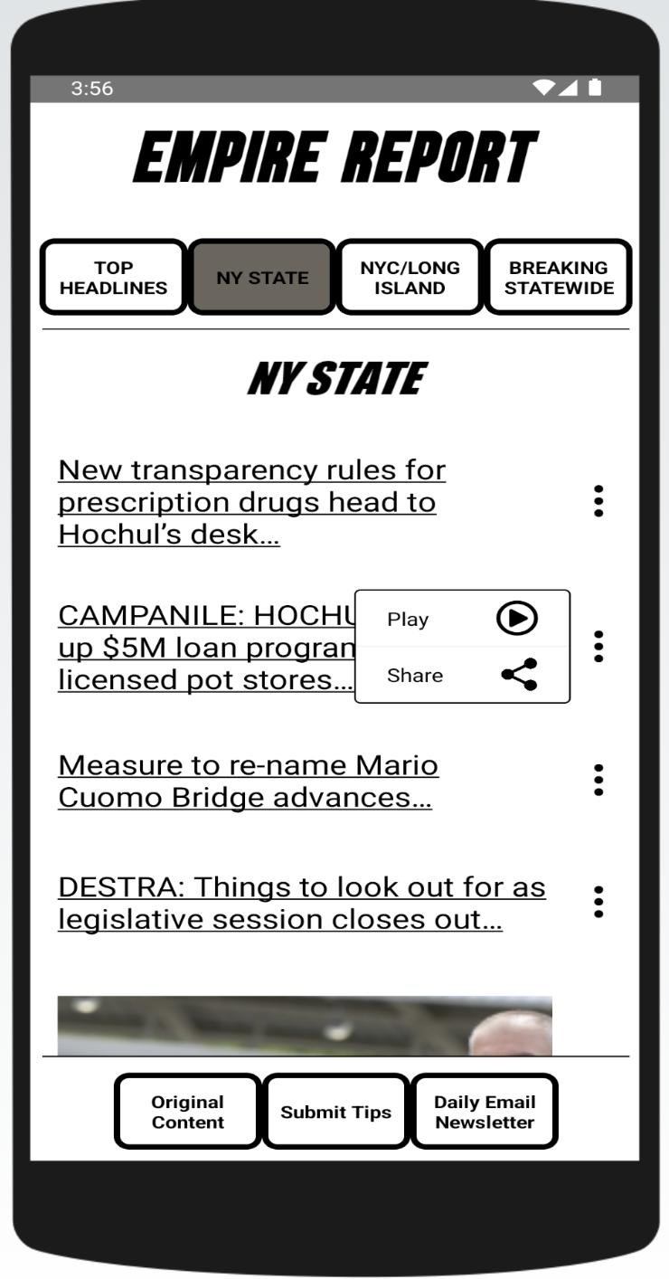
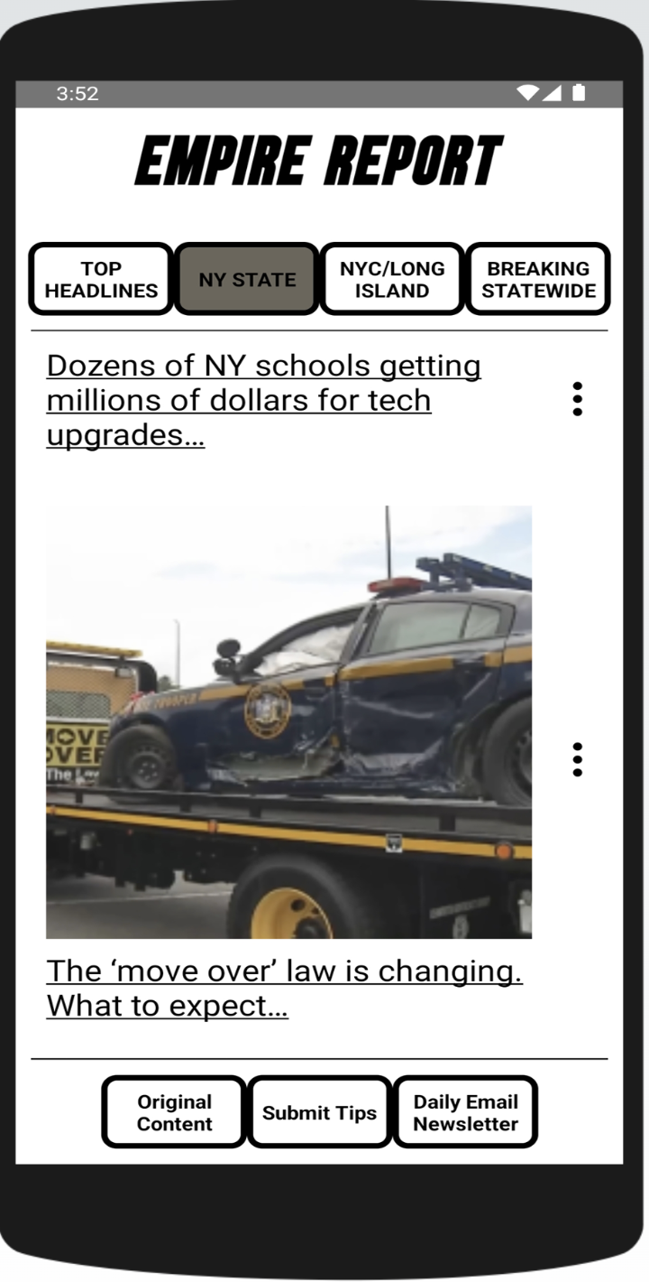
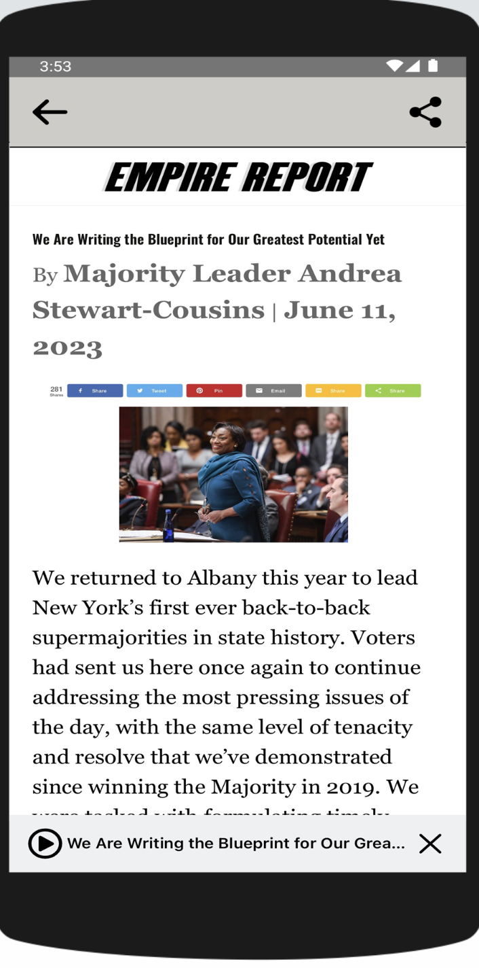
Empire Report
The Empire Report application is to access authentic news and reports published in and around New York base area.
This application has been developed for iOS & Android devices.
iOS URL - https://apps.apple.com/in/app/empire-report-app/id1548705748
Playstore URL - https://play.google.com/store/apps/details?id=com.perchcreek.empirereportapp&hl=en_IN

Slide 15
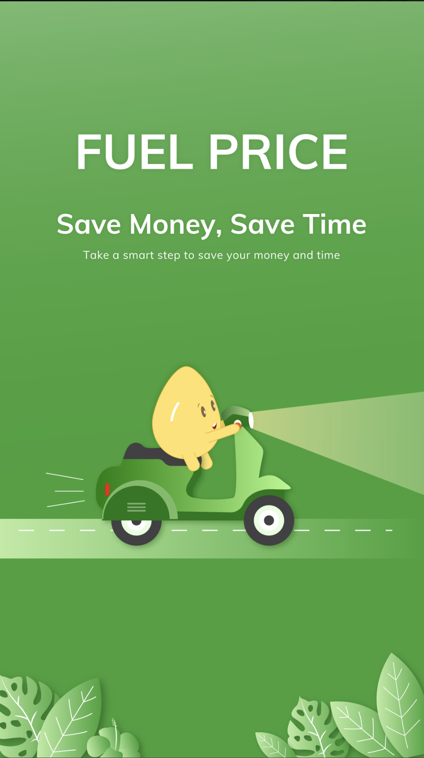
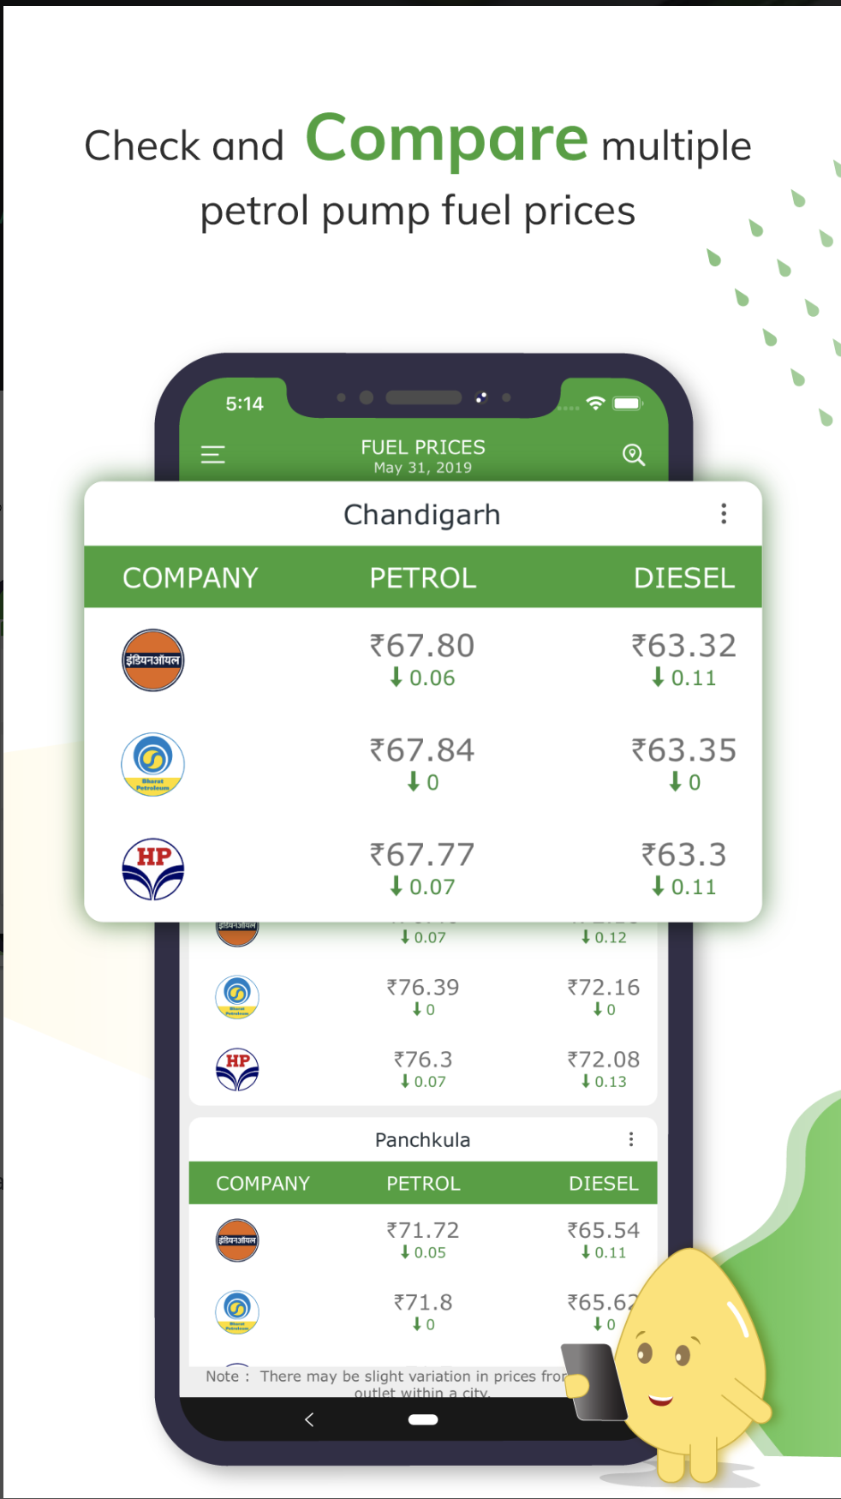
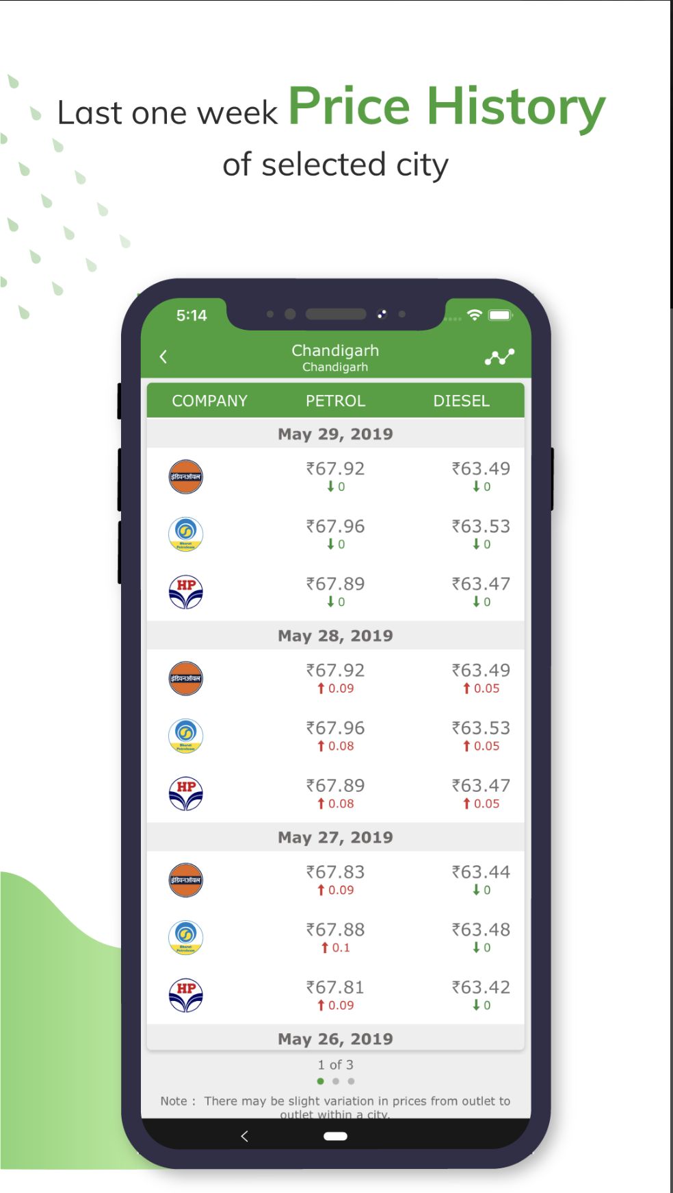
Fuel Price
The Fuel Price application is your AI Mental Health and Wellness Coach for your daily guidance and professional care.
This application has been developed for Android devices.
Playstore URL - https://play.google.com/store/apps/details?id=skycap.petroldiesel.fuelprice&hl=en_IN

Slide 16
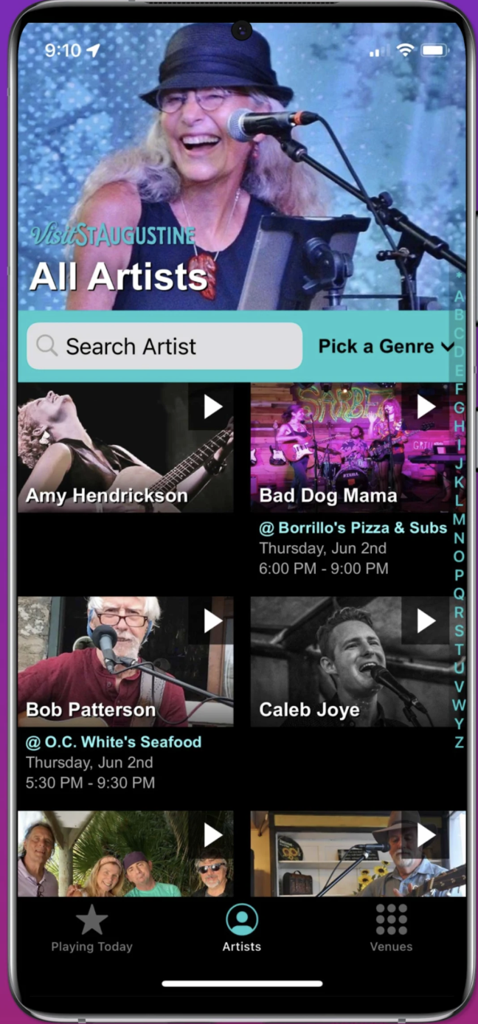
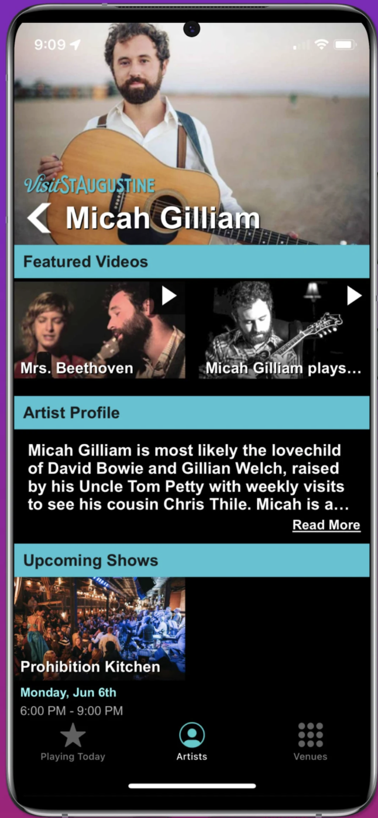
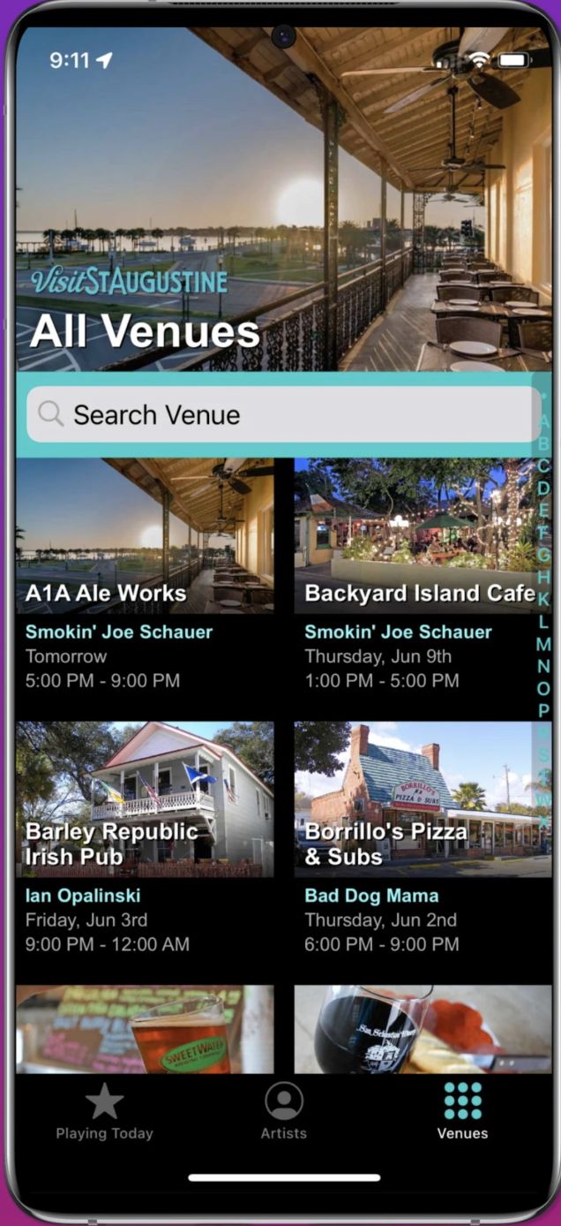
St. Augustine Live Music
The St. Augustine Live Music application is share and update the various venues and local artists to listen to in and around the city.
This application has been developed for Android devices.
Playstore URL - https://play.google.com/store/apps/details?id=com.skycap.augustinemusic&hl=en_IN

Slide 17
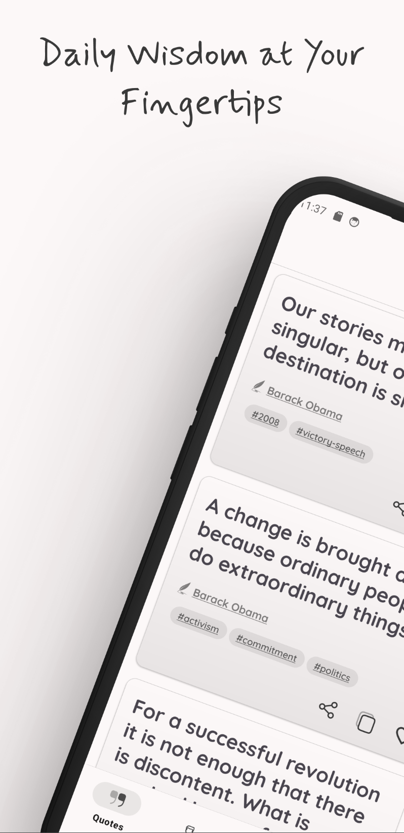
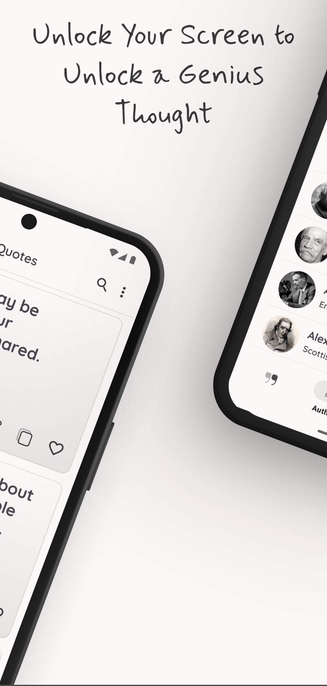
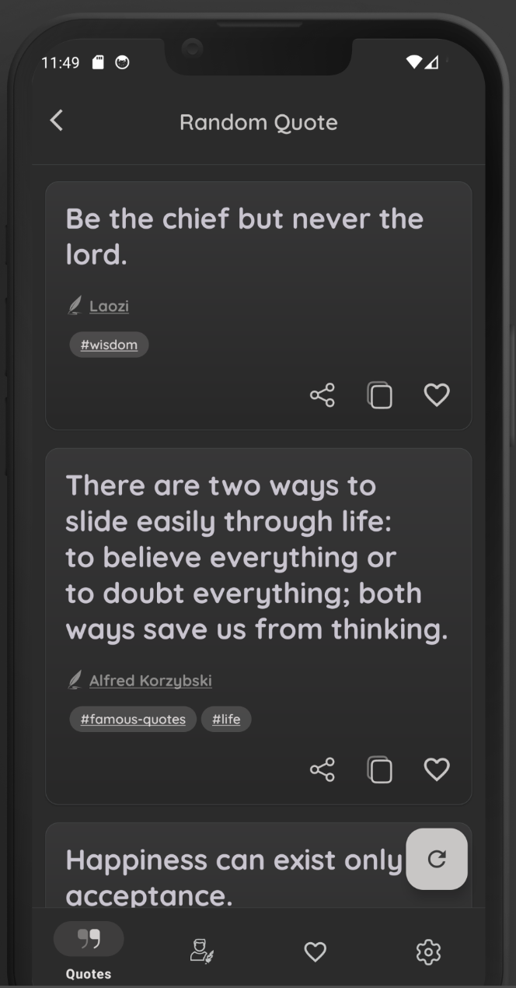
Quote-Gen
The Quote-Gen application is read and share daily motivational quotes and category based quotes.
This application has been developed for Android devices.
Playstore URL - https://play.google.com/store/apps/details?id=info.quotegen.quotes&hl=en_IN

Slide 18
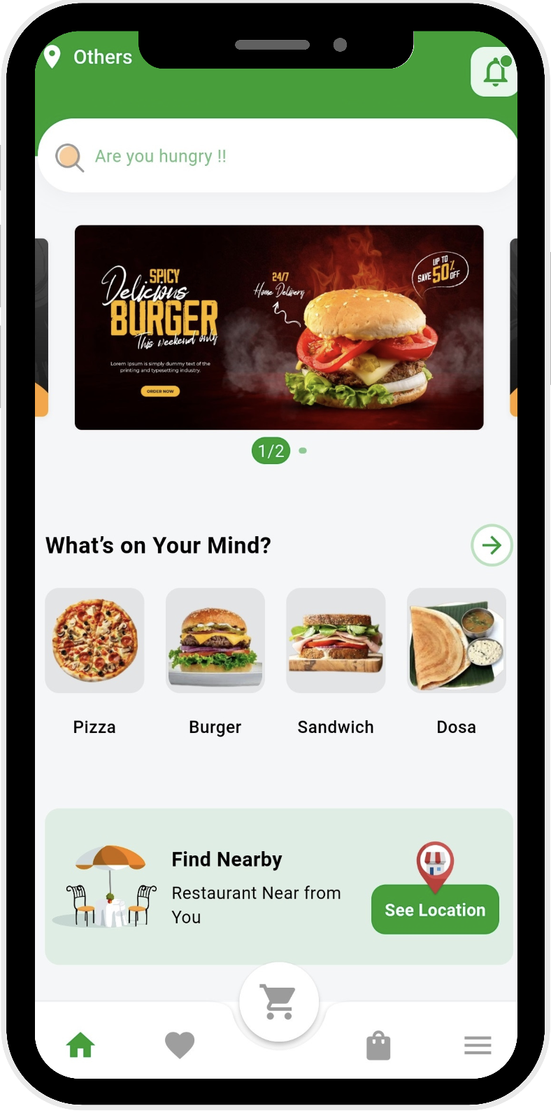
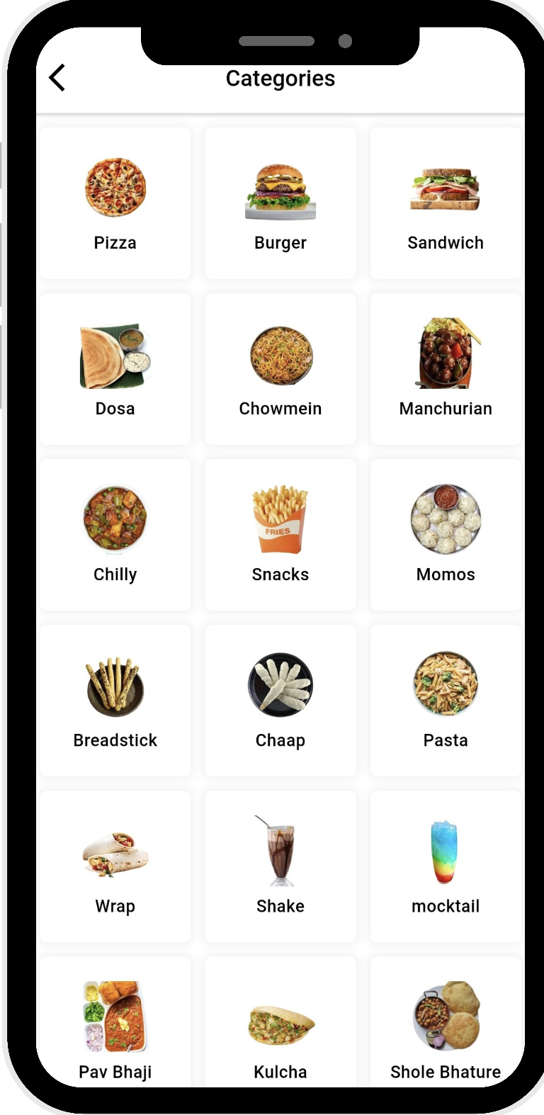
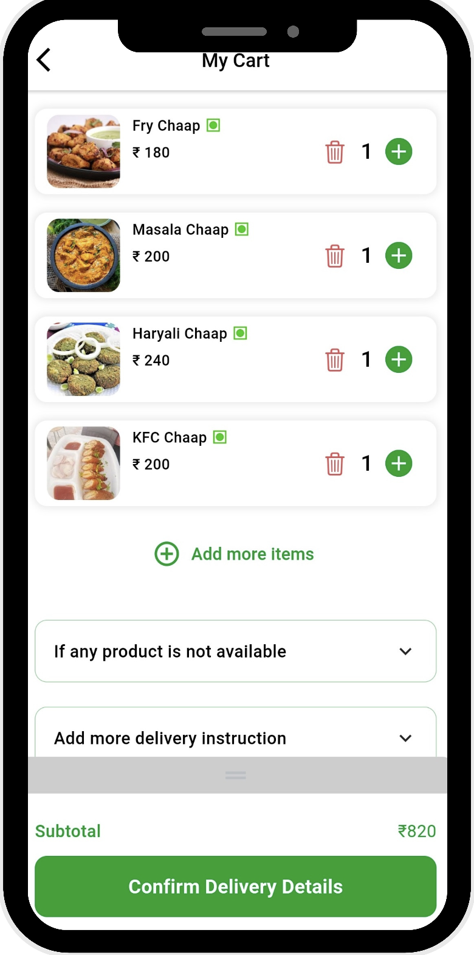
Farista – Home Delivery Services
The Farista application is a nearby food - direct to home delivery application.
This application has been developed for iOS & Android devices.
iOS URL - https://apps.apple.com/in/app/farista/id6744963715
Playstore URL - https://play.google.com/store/apps/details?id=com.farista.customer

Slide 19
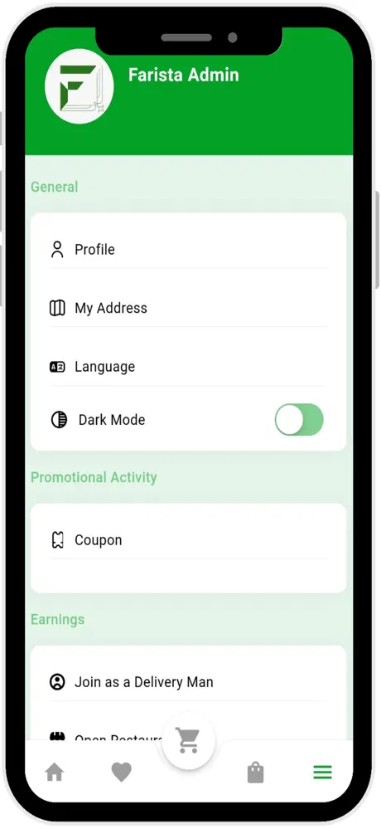
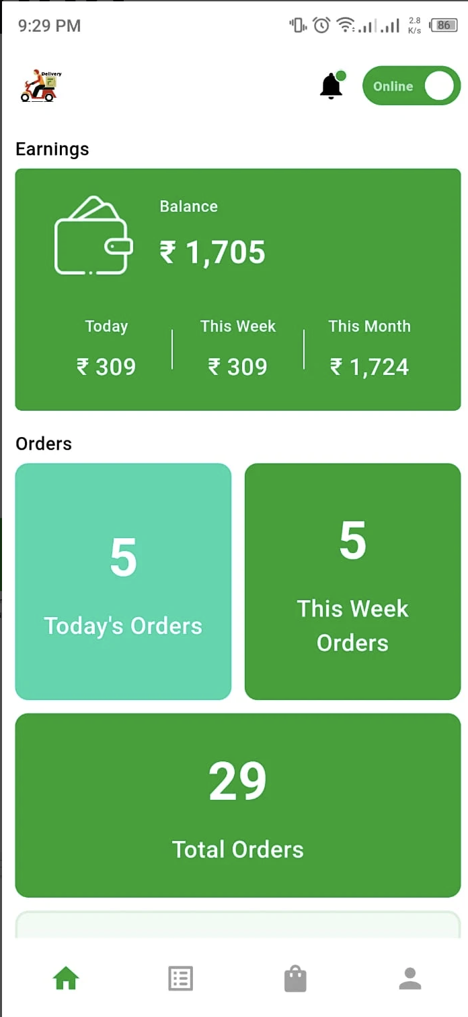
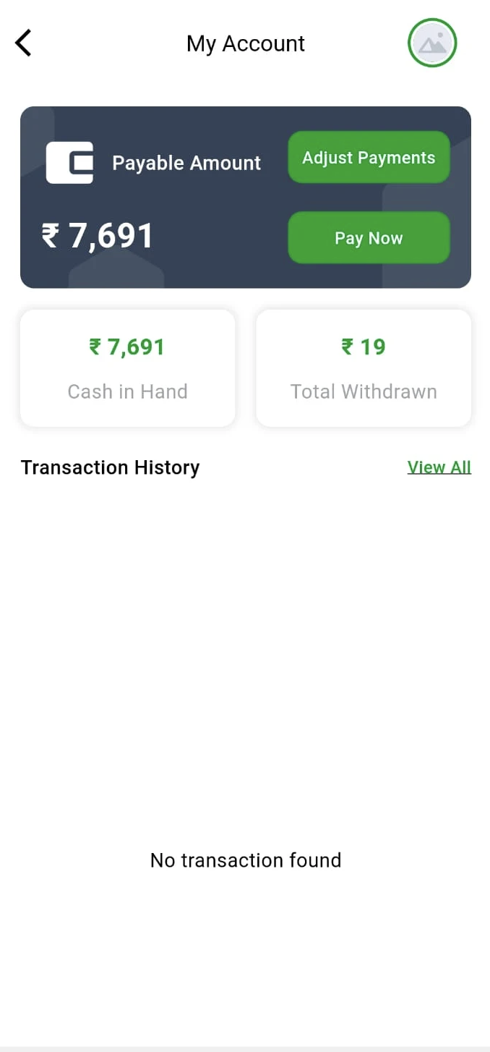
Farista – Restaurant Partner & Deliveryman Apps
The Farista Business applications are your Restaurant partner and delivery man applications to support the request and fulfillment.
This application has been developed for iOS & Android devices.
iOS URL - https://apps.apple.com/in/app/farista-restaurant-partner/id6743747041
Playstore URL - https://play.google.com/store/apps/details?id=com.farista.delivery

Slide 20
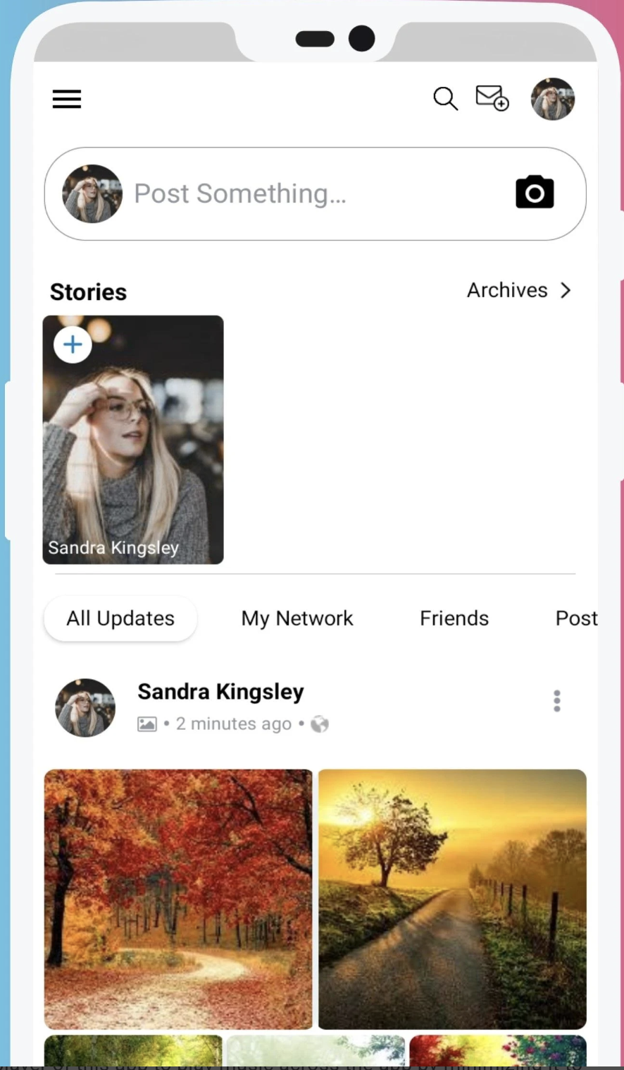
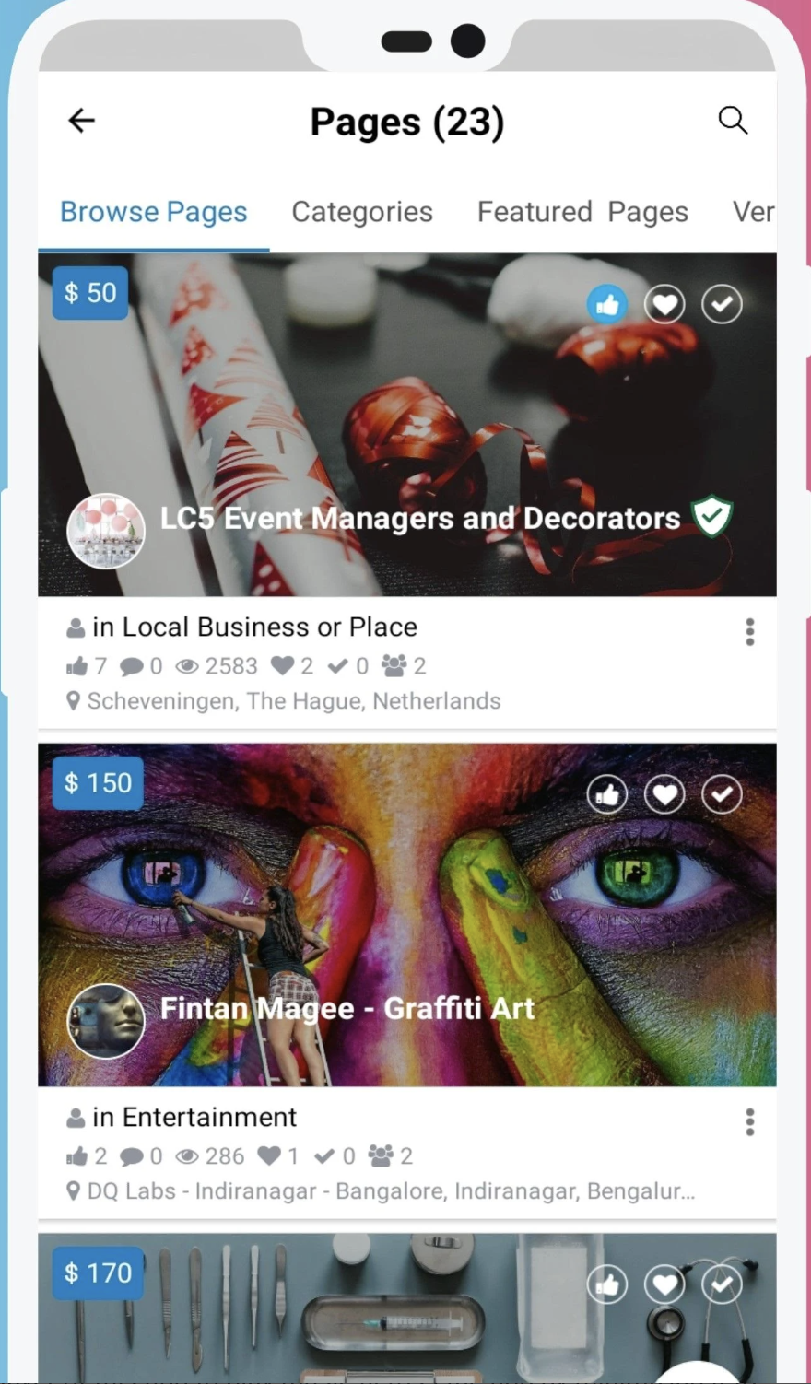
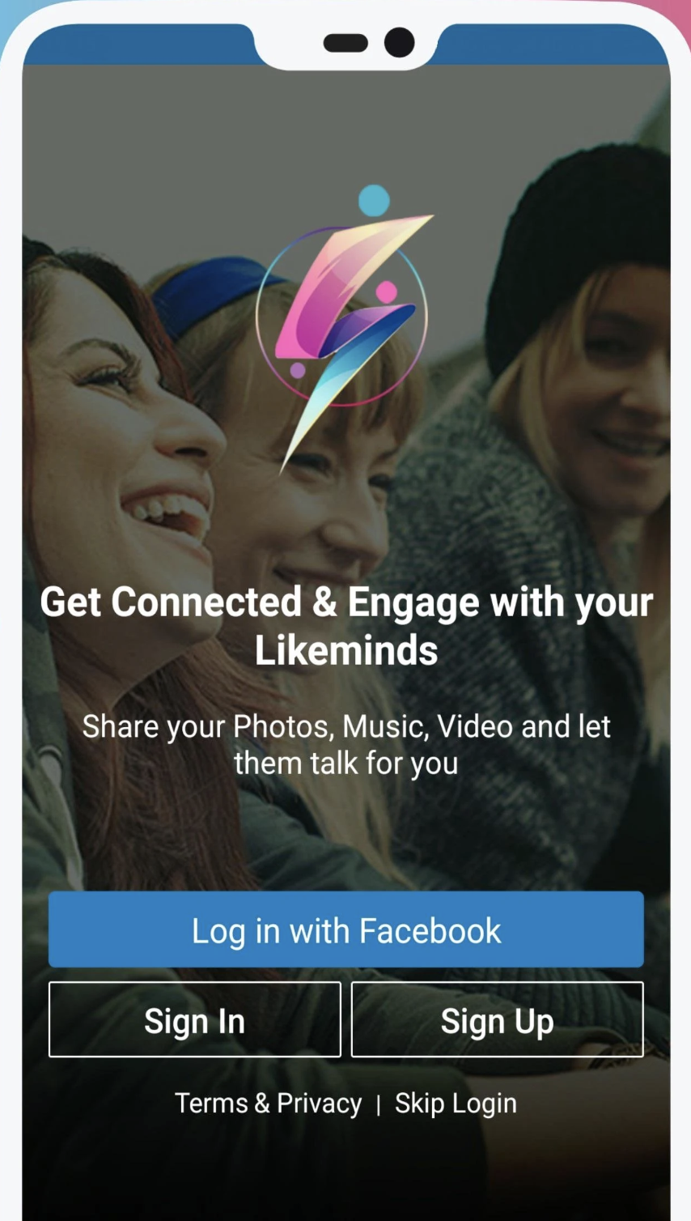
Social Engine
The Social Engine application is to share your feelings, whereabouts, to do list etc with friends and family.
This application has been developed for Android devices.
Playstore URL - https://play.google.com/store/apps/details?id=com.sesolutions

Slide 21
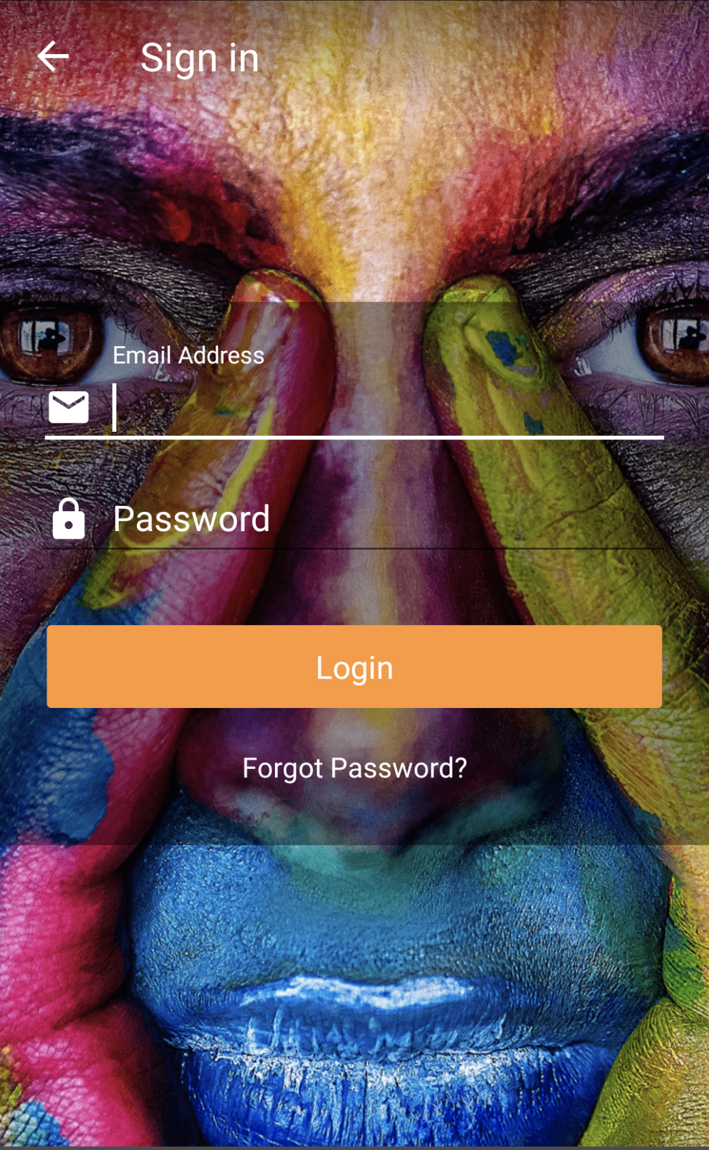
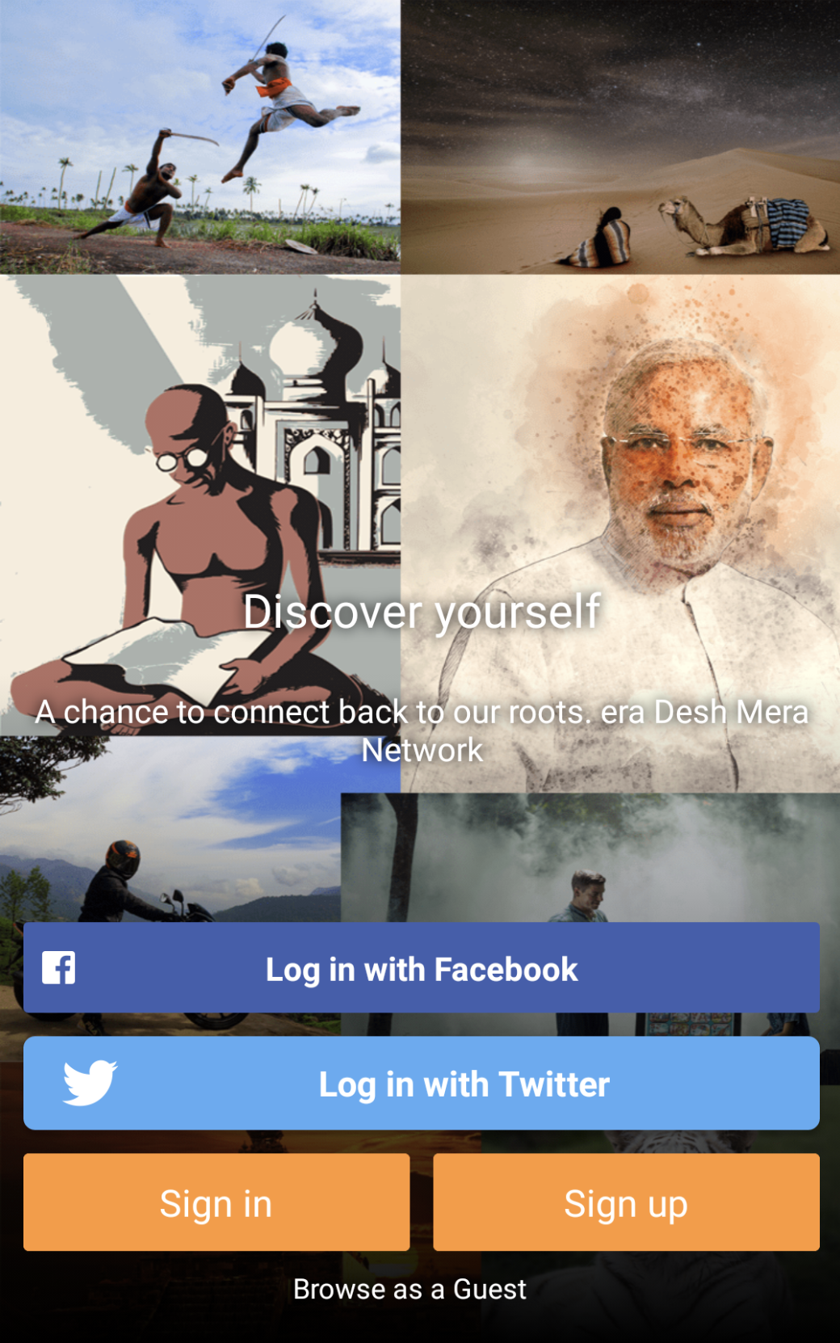
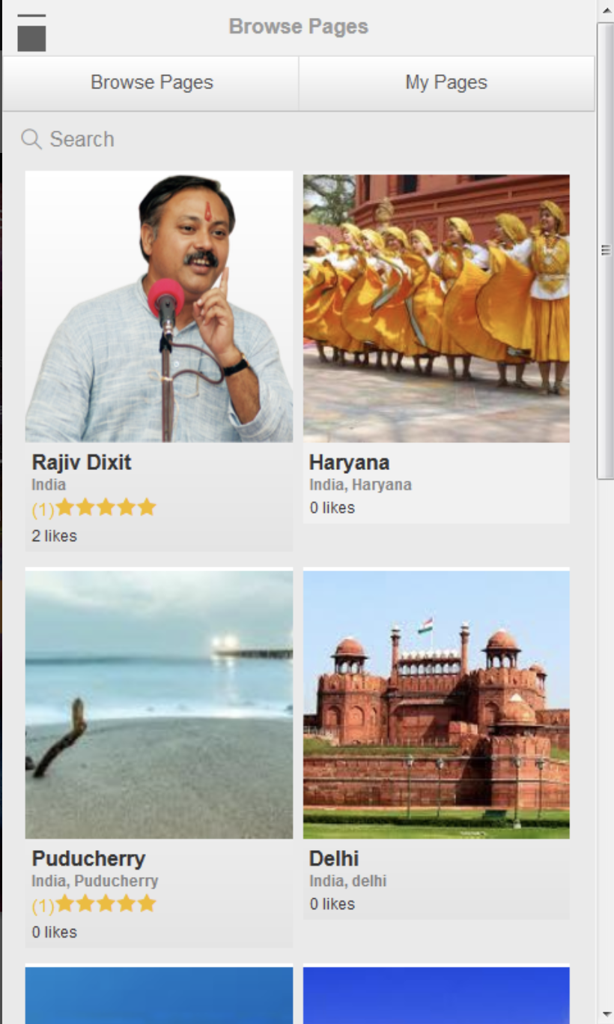
Inbook: Indian Social Media
The Inbook – Indian Social media application is to share and follow your friends and family with their photos, videos and what they like.
This application has been developed for Android devices.
Playstore URL - https://play.google.com/store/apps/details?id=in.inbook.app

Slide 22
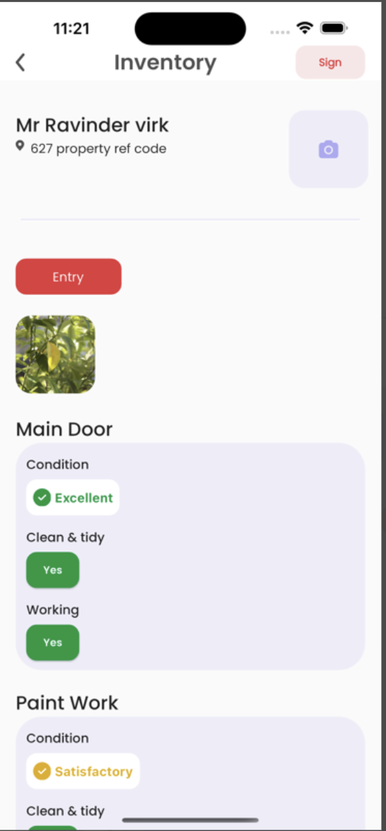


Denhan Inventory
The Denhan Inventory application is for Real Estate Property and Inventory management for end customers.
This application has been developed for iOS & Android devices.
Playstore URL - https://play.google.com/store/apps/details?id=in.co.skycap.denhanInventory.denhan&hl=en_IN

Slide 23





Insulsafe - A Saint-Gobain Application
Insulsafe, A Saint- Gobain application for insulating the attic and performance management
The application was developed for iphone, ipad, android and tablets with an offline feature and in-app cost calculator.

Slide 24







Mexo - A Cab Booking Application
Mexo is a cab booking application system for the consumer as well as the driver.
The trips can be booked and the cost estimates are recorded.

Slide 25












Movado - A Fashion E-Commerce Application
Movado app is a fashion app made for introducing watch models to the masses and raise public awareness.
The user has the ability to search, filter results, browse details and buy from a large collection of Movado watches.

Slide 26



Bee ERP- Logistics Management & Tracking Application
Bee ERP is a full blown ERP system for a South African logistics company.
It takes care of order management, finance, fulfillment of orders along with the efficient operational tracking and revenue.

Slide 27


ICEGOV - International conference Application
This app was designed for the 10th International conference on theory and practice of Electronic Governance.
Skills: iOS 8.0, iOS 9.0,
Swift, Xcode 7, HockeyApp, HTML

Slide 28



Myish - A Blogging Application
Myish is a blogging application to share interesting images for food and fashion. Users from your area give feedback with either a 'Yay or a Nay' through a simple swipe on everything that they see on Myish.
It has a social media engine to connect and build a network of people with common likes, dislikes and tastes.

Slide 29



Bottomzup - A Restro-bar Explorer Application
Bottomzup is a restrobar explorer app with pricing and offer indication and public awareness of the quality of the place.
It also has loyalty programs and offers. The app was built for iOS and Android.

Slide 30



SmartPlate – Application for a Bluetooth Enabled IOT Device
Smartplate is a bluetooth enabled IOT device connected to the application.
The plate shares the calorie count of the dishes served and identifies the diet and lifestyle of the individual.

Slide 31





Holbe – A Fitness Tracker Application
Holbe is a fitness application tracking the meals along with the workout and other supplement intake of an individual.
It displays the tracking of day to day activity and fitness of an individual.

Slide 32

Glimpse Analytix – A Psychological Analytical Application
Glimpse analytix is a psychological analytical app which assess and records the patient details as per the questionnaire.
Built on native platform for both iOS and Android.

Slide 33




Mylan Pharma – A Medical Assistance Application
Mylan pharmaceuticals app was for diabetic patients to keep track of the injection site and the dosage on a daily basis.
The app was developed for both iOS and Android.

